Slide 1

Next steps, compliments and greetings from the Netherlands
Closing conference Children and Youth at risk,
Prague 1 June 2017

Slide 2
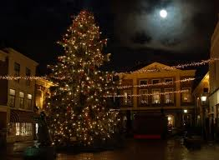

Did we meet before?
Friendship Brielle – Havlickuv Brod
2 conferences
2 study visits

Slide 3
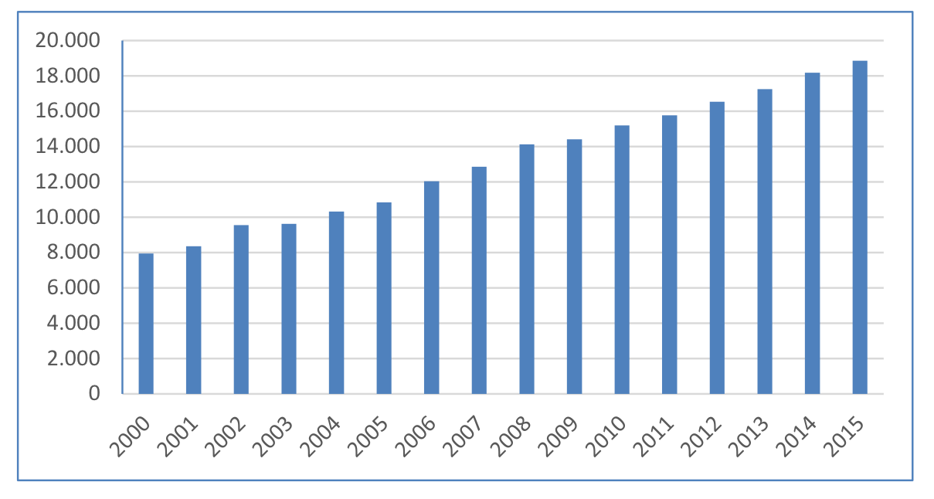
Number of foster children

Slide 4

a new orientation: from welfare state to participation society
Old/passive: the client as customer
New/activating: how are you gonna solve your own problem?
(Stephen Covey: personal leadership).

Slide 5
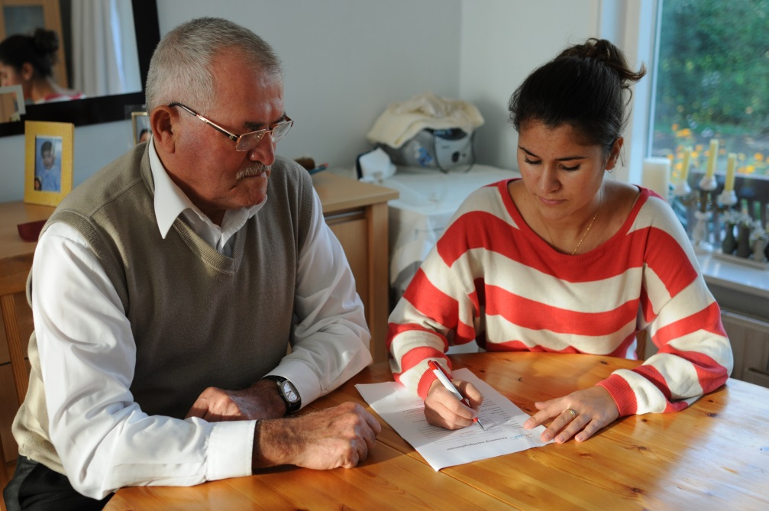
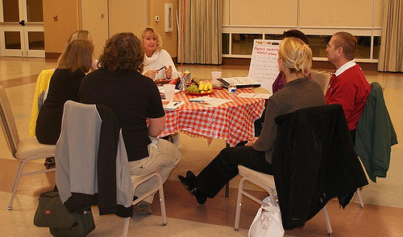
The kitchen table conversation

Slide 6
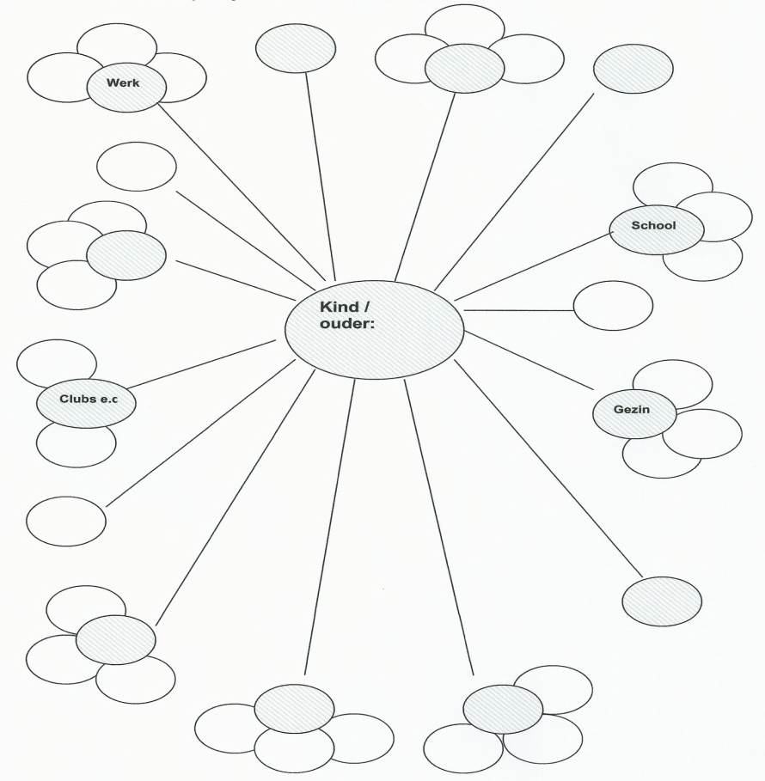
The polka dot schedule
family
friends
neigbours
church
sportsclub.

Slide 7
New role of the social worker
Network : descibe
repair
activate
Family group conference
Kinship care (is no second choice)
“Good enough” parents.

Slide 8
working with a safety plan; a new attitude towards domestic violence
-father is obliged to look for help
-father will register how he feels: green/orange/red
-situation orange/red: the children will go to grandmother, just round the corner
-neigbours know about the problems. They will call the police
At the end: not mother and the children will leave the house, but father.

Slide 9
DI de-institutionalization
Is not closing childrens homes and promote foster care,
goal is to prevent outplacements and strengthen families

Slide 10
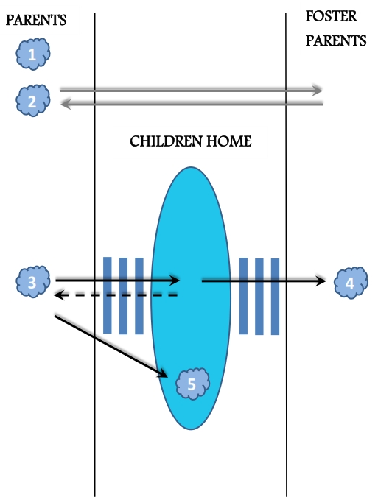
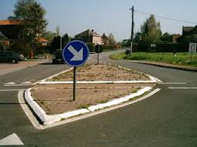
Our schedule

Slide 11
How to finds more foster families
An unusual proposal: let’s look at the world of (inter)country adoption

Slide 12
Adoption in the Netherlands
In country adoption: 50 in 2016*
International adoption: 1779 in 1980
216 in 2016**
* Tolerance towards single mothers, anti conception and legal abortion
**Scandals, Olympic Games South Korea.

Slide 13
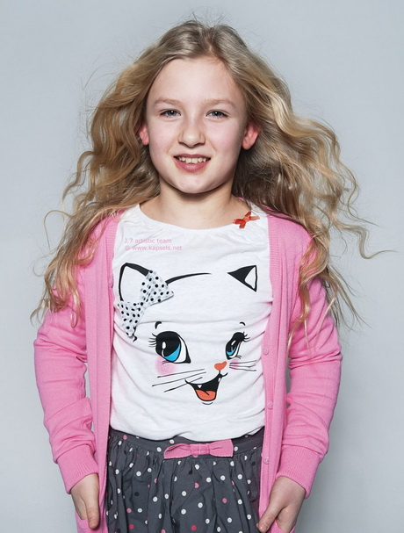
adoption
Adoption, half adoption, open adoption, pre-adoption foster care, incomplete adoption, foster parents with parental authority, ….. confusing!
They say:
Adoption is having a child
Foster care is helping a child

Slide 14
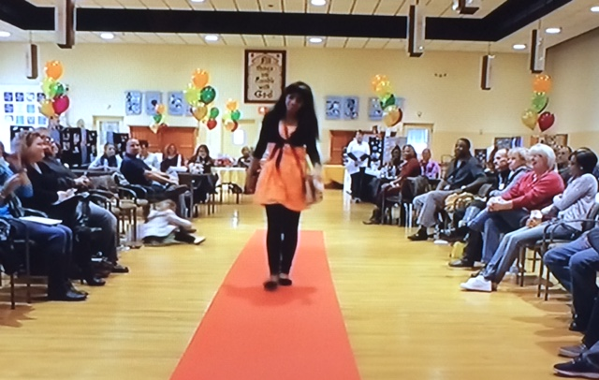
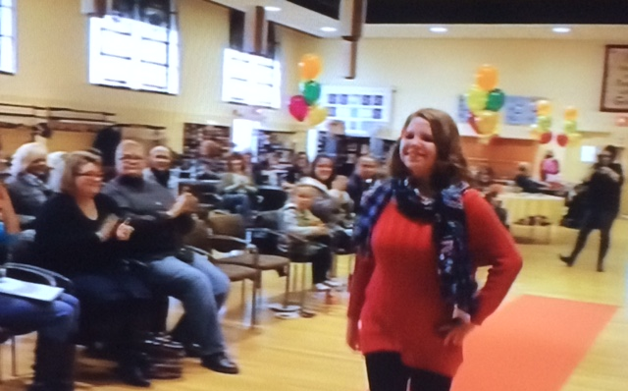
Rehoming in the USA: red carpet show second hand adoption

Slide 15
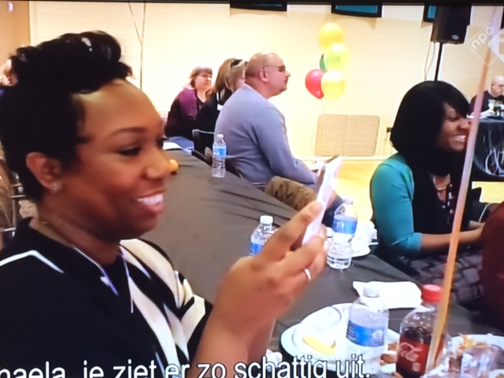
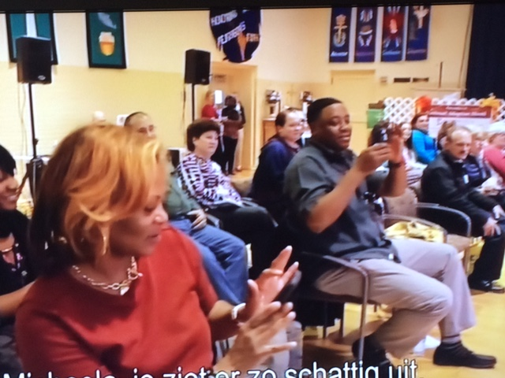

Slide 16
To compare
all foster children have behavioral problems and family contacts are a problematic
adoption is about normal children without these complications
That’s why families who adopt have to do it alle alone
while foster families are coached by a social worker.

Slide 17
Foster families get an allowance/salary,
people who want to adopt (from abroad) have to pay a lot of money

Slide 18

Misunderstandings
That terrible social worker or help and control
That ungrateful child or trauma
Those unreliable parents or life long loyality

Slide 19
What do your neigbours know about foster care and adoption??
Now families who want to adopt have to wait very long (only special needs children are availble), while foster care agencies urgently need new families
My mission is to bring these two worlds together: start with joint information meetings. Both is about “someone else’s child”

Slide 20
so
Compliments for all that you reached
Foster care and residential care are no ennemies, not all children can live in a family
don’t take over all responsibilies: “parents how will you solve your problems”
Bring the world of foster care and adoption together
Go on with the Christmas trees
And watch LION

Slide 21
Contact: r.de.bot@theknowledgefactory.nl

